Slide 1

By
Arvind Kumar. D
Krishore. M
Badri Narayanan. M

Slide 2

The aim of the project is to automatically allocate the desired group for Higher Secondary students using their marks obtained in the Matriculation Examination.

Slide 3

Use novel techniques for automatically allocation the group for the students. The main objective of the project is to reduce the manual work that is required in the allocation of the goups. The allocation of the group will be based on the marks obtained in the Matric Examination.

Slide 4

The primary problem for allocating the group is the existence of lot of manual work which is involved in the current procedure followed.
Due to existence of lot of manual work, the procedure is prone to lot of manual errors.
There are a lot of steps which involves collection of information which may sometime contain irrelevant information.

Slide 5

The information are collected and checked manually which involves the lot of human work and attention.
Next problem is we cannot simply store the information, we need to look back for each data and correct the data if something wrong is given.
The identification of a particular record is difficult.
Further the problem of extracting the data from collection of documents is time consuming

Slide 6

Using the manual work for processing and allocation of group.
The correctness of the Allocated group depends on the manual work.
Mostly prone to errors in allocation of group.
The detection of errors and correction of errors is difficult.

Slide 7

Error Free.
Time consumption is less.
Detection and correction of the errors is easy.
Manual processing is reduced.
Automatic allocation of Group.

Slide 8

FRONT END : JAVA
BACK END : MS-Access

Slide 9

The students are allowed to enter their details such as name, subject marks and total marks, who are accompanied by a instructor.
The data is stored in the database.
The administrator checks the information stored in the database.
If any incorrect information is found, it may be corrected only by the administrator.
The number of seats in each group is entered by the administrator.

Slide 10

Once all the data is stored, the processing is done.
After processing the allocated group can be printed by the administrator.
The allocated group is also stored in the database.
The administrator enters the number of seats in each group and the total no of seats.
Then the administrator processes the data.
The allotted group will be stored in the database.

Slide 11

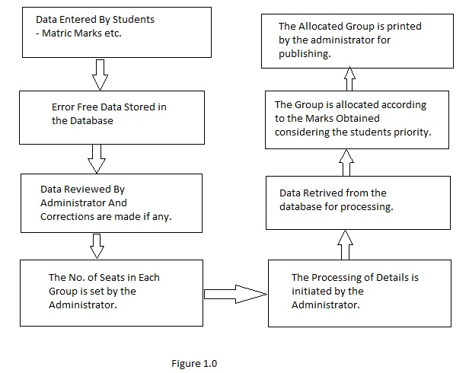

Slide 12
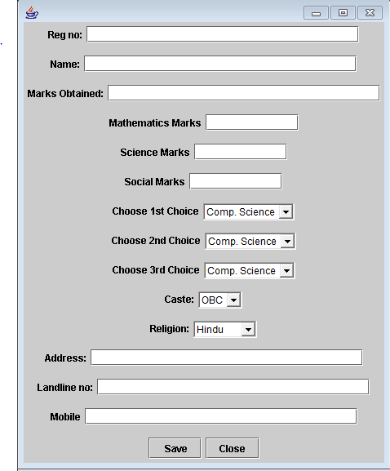
DATA IS COLLECTED FROM THE STUDENTS:

Slide 13
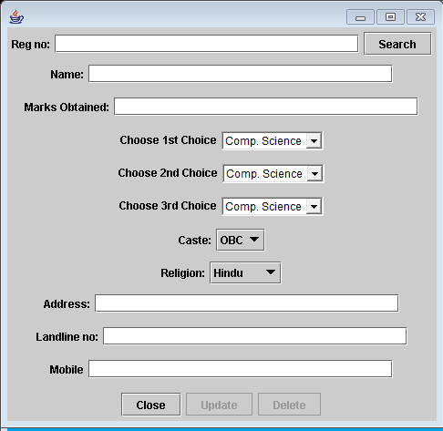
Window for searching and Editing Records

Slide 14
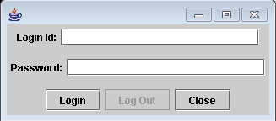
Login Window for Admin

Slide 15
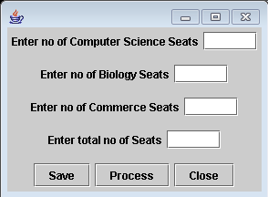
Processing Window

Slide 16
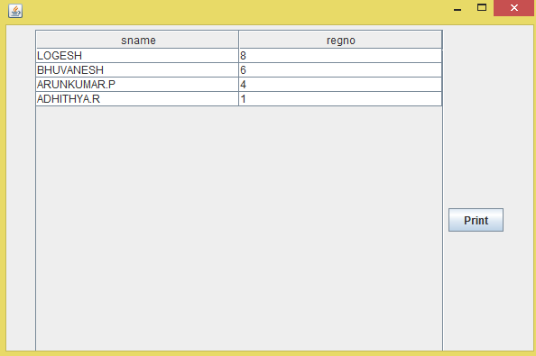
Viewing Allocated Group

Slide 17
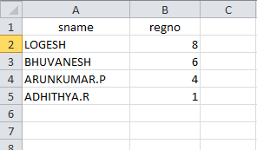
Data Exported For Printing

Slide 18
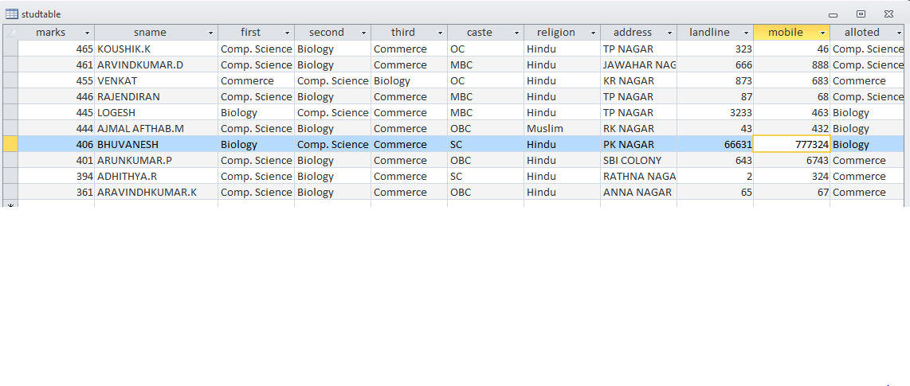
Processed Data Stored In Database

Slide 19

Thus the Students details are collected, processed and the group for their higher secondary studies is allocated automatically by using new methods, thereby reducing the manual works which have also reduced the errors in the processing.

